Slide 1


Time series analysis for coupled neurons
Indranil Ghosh
https://indrag49.github.io
6 September, 2025
Email: indra.ghosh@ucd.ie

Slide 2
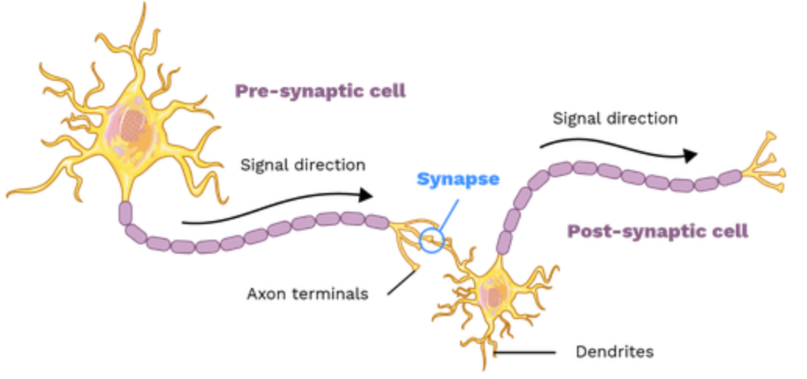
Neurons
Neurons are the fundamental units of the nervous system.
Billions of neurons couple through ‘synapses’ to form a cluster of a highly complex neural mass.
Their mechanism evolves in time.
Thus can be perceived as a `dynamical system’.
Fig. A typical synapse (theory.labster.com/synapses/)

Slide 3
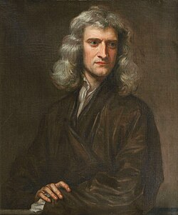
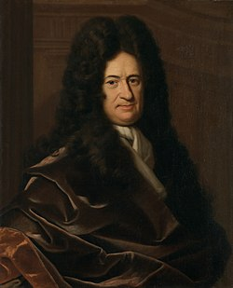
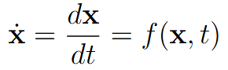
Dynamical systems (ODEs)
ODEs : Ordinary Differential Equations.
Rate of change of a physical quantity over time.
Generates a data of time series, given an initial time stamp.
Fig. Newton and Leibniz (Wikipedia)

Slide 4
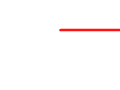
Chaos
In popular term a ‘state of disorder’.
In mathematical term, it must be sensitive to initial conditions and have a dense orbit in the phase space.
Chaotic systems behave predictably in the beginning before becoming random.
Fig. Double-rod pendulum exhibiting chaos (See en.wikipedia.org/wiki/Chaos_theory)

Slide 5



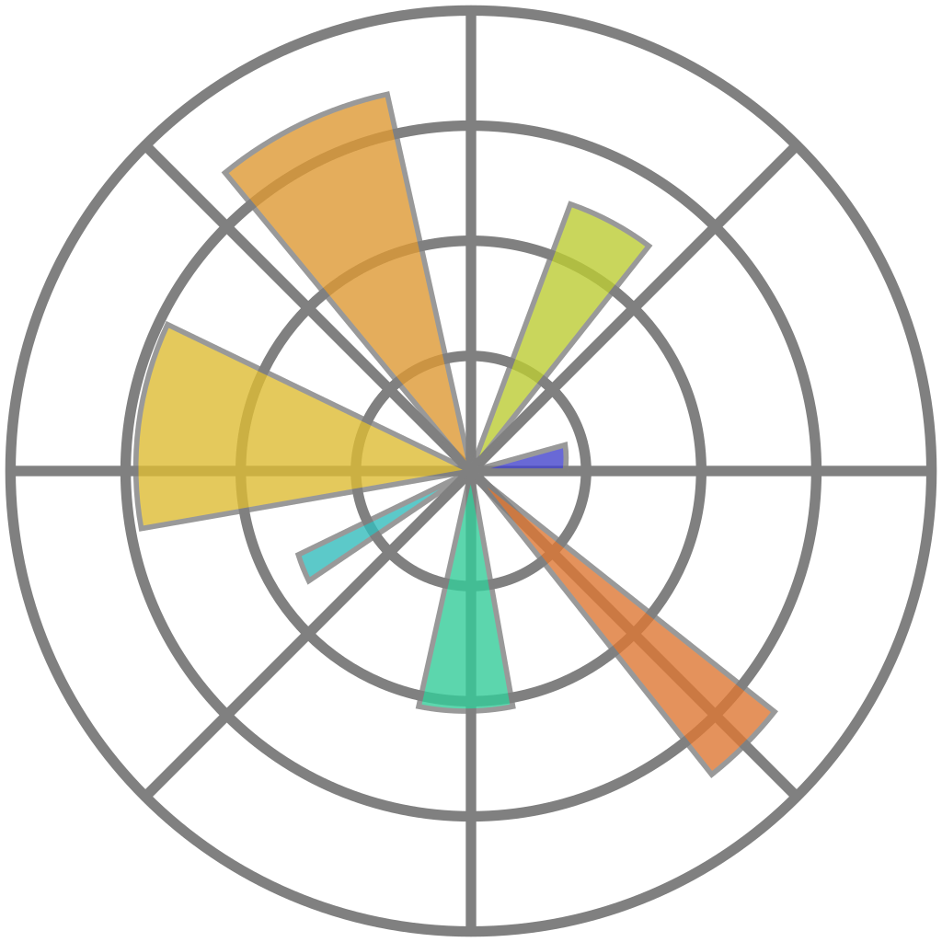
Packages

Slide 6
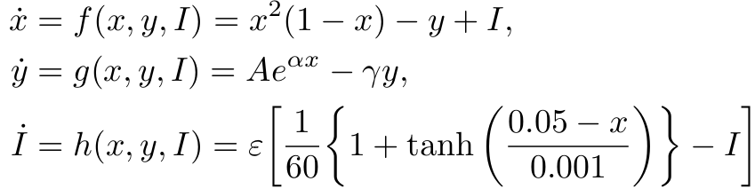
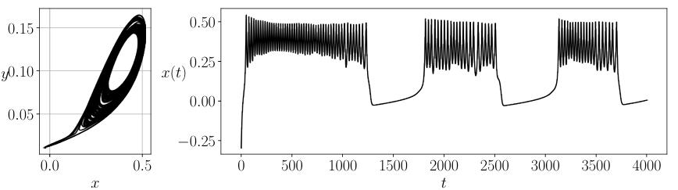
Single neuron (Schaeffer & Cain, 2018)
Simple mathematical model.
Parameters selected from empirical experiments.
Captures realistic bursting in neurons.
Portrays a battery of complex dynamics.
Use `solve_ivp()`function from `scipy.integrate` suite to solve initial value problem.
Fig. 3. Phase portrait and time series

Slide 7
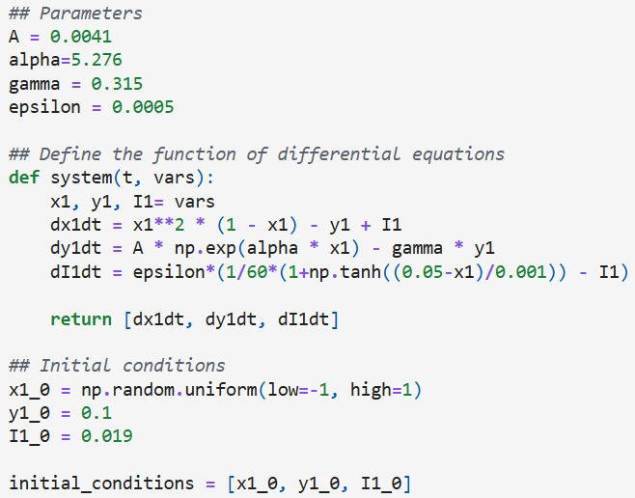
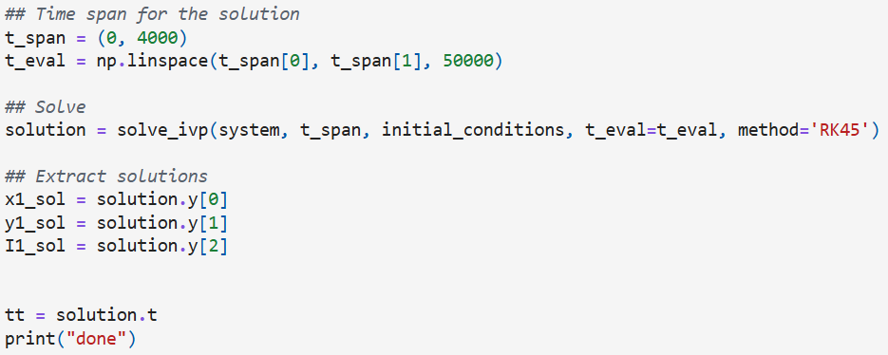
Simulate a single neuron (code snippet)
For the time integration of the differential equations, we use method = ‘RK45’ which is the explicit Runge-Kutta scheme of order 5(4).

Slide 8
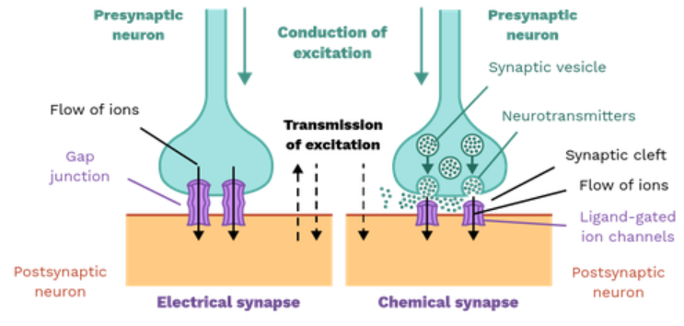
Coupled neurons
Fig. 4. Coupled neurons (https://theory.labster.com/synapses/), and typical electrical and chemical synapses (theory.labster.com/electrical-synapses/)

Slide 9
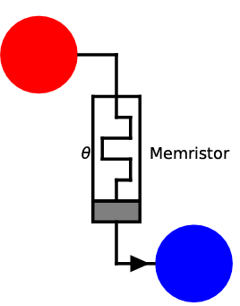
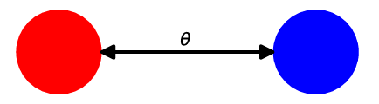
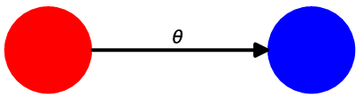
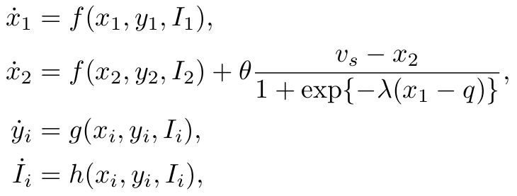
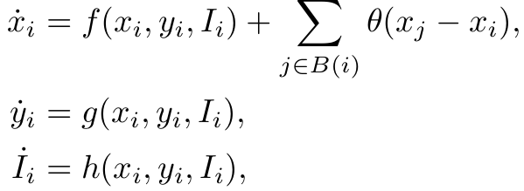
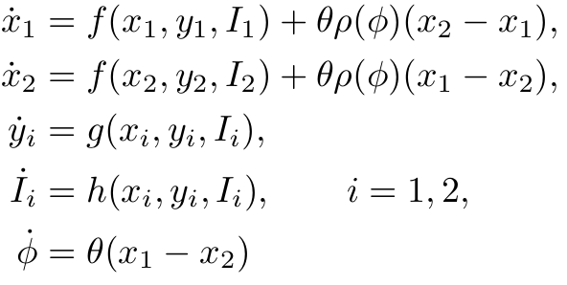
Toy models of coupled neurons
Fig. 5. Electrical (gap-junction) coupling
Fig. 6. Chemical coupling
Fig. 7. Electromagnetic coupling

Slide 10
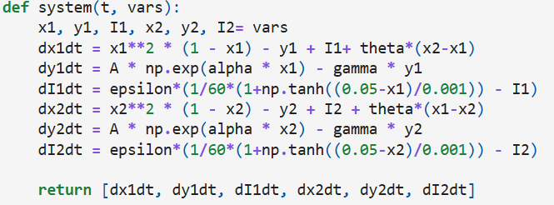
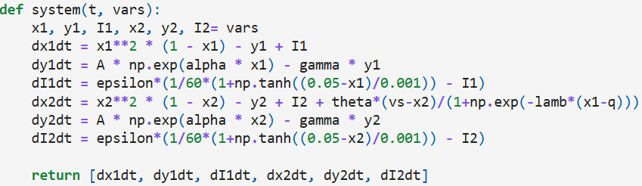
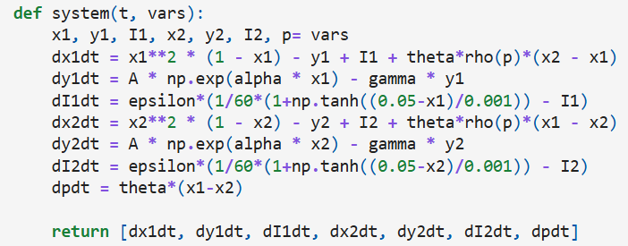
Simulating coupled neurons

Slide 11
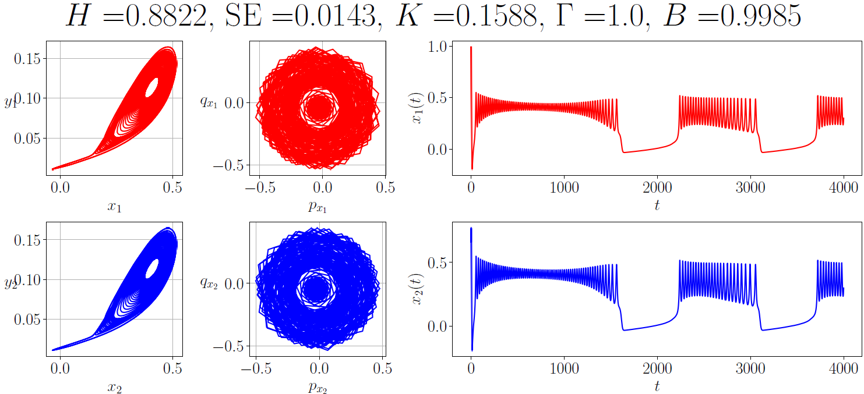
Time series tools
Hurst exponent (H): measuring persistence.
Sample entropy (SE): measuring complexity.
0-1 test (K): measuring chaos.
Cross-correlation function (Γ): measuring synchrony between neurons.
Kuramoto order parameter (B): measuring synchrony between neurons.
Fig. 8. Applying various tools on the time series generated from simulating the models of coupled neurons.

Slide 12
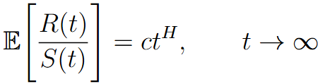
Hurst exponent (Hurst, 1951)
Measures the long-term memory/persistence in time series.
Computed using rescaled-range analysis (Qian and Rasheed, 2004).
H ∈ [0,1].
H ∈ [0,0.5): anti-persistence (negative dependence on previous values), H ≈ 0.5: random walk, H ∈ (0.5,1]: positive dependence on previous values.

Slide 13
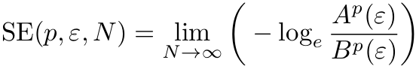
Sample entropy (Richman & Moorman, 2000)
Assesses the complexity of time series data.
It is the negative natural log of the probability that if two sets of simultaneous data points of length ‘p’ have distance less than ‘ε’, then the similar thing happens to two sets of simultaneous data points of length ‘p+1’.
A higher SE indicates higher complexity.
Can be normalised between 0 and 1.

Slide 14
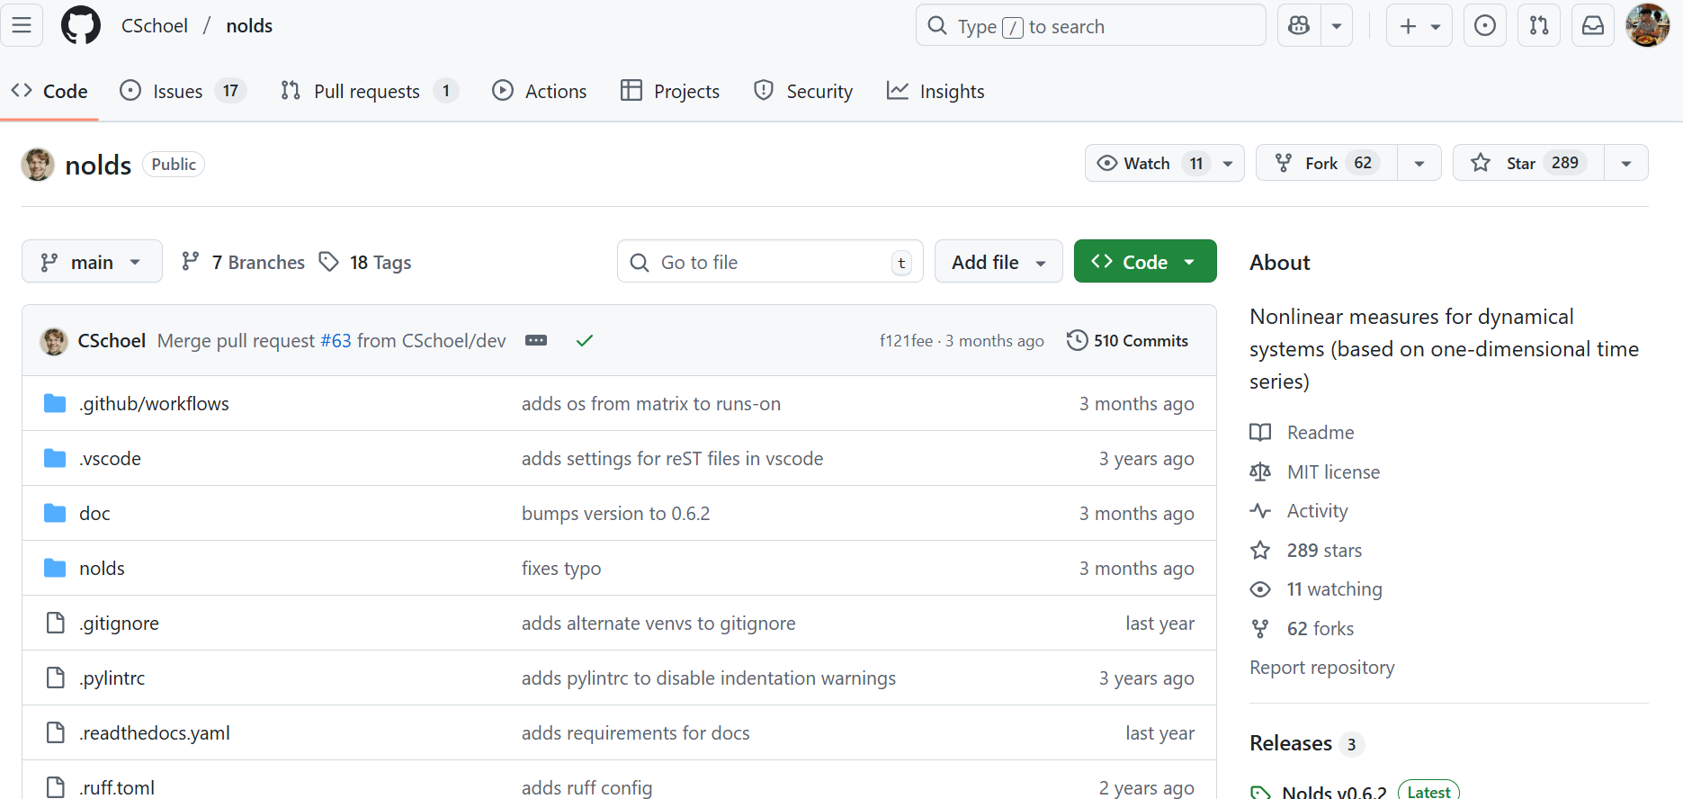
‘nolds’ package (Scholzel, 2019)
Stands for ‘NOnLinear measures for Dynamical Systems’, based on .
Provides functions for directly implementing the rescaled-range based Hurst exponent and also sample entropy to time series.
Functions are `nolds.hurst_rs()` and `nolds.sampen()`.
Also provides other sophisticated tools for nonlinear measures.

Slide 15
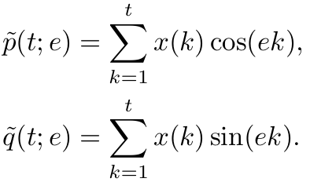
0-1 test (Gottwald and Melbourne, 2009, 2016)
Compute two translated variables from the time series.
Then compute a mean square displacement term ‘m(t; e)’ and a correction term.
Compute the growth rate ‘K’ that quantifies ‘chaos’.
‘K ≈ 0’ indicates regular dynamics and ‘K ≈ 1’ indicates chaos.

Slide 16

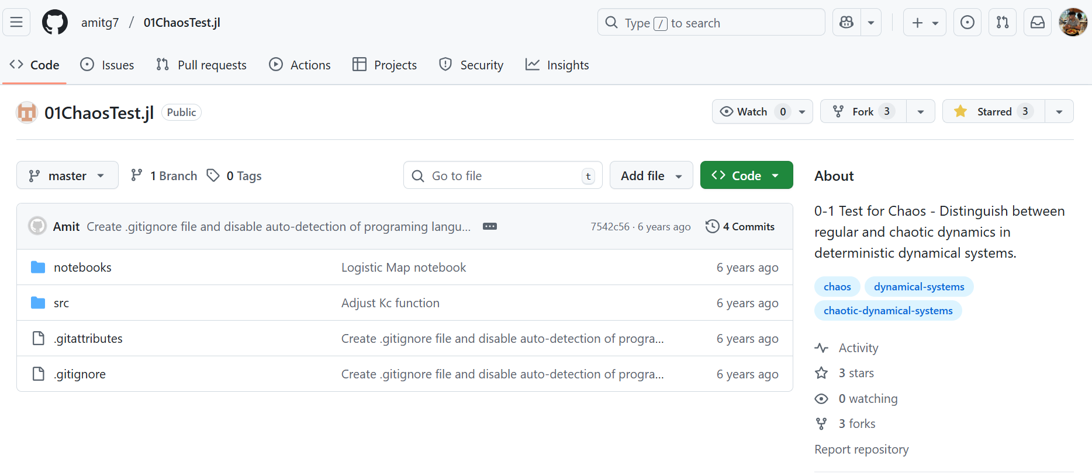
A package for 0-1 test
Translated to .
Used `curve_fit()` and `fsolve()` functions from the `scipy.optimize` suite.
Used `pearsonr ()` function to compute Pearson’s correlation coefficient from `scipy.stats’ suite in one of the steps.

Slide 17
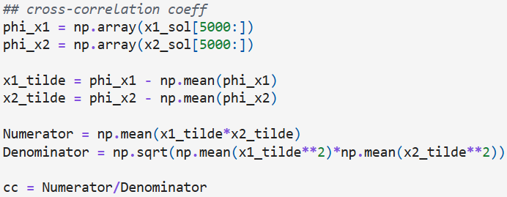
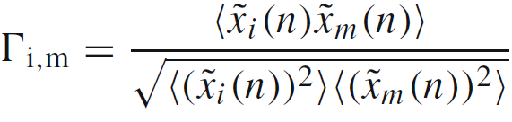
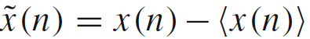
Cross-correlation coefficient (many authors)
For two time series from nodes ‘i’ and ‘m’, Γ is given by
The average is calculated over time and the variation from the mean is
|Γ| = 1 indicates total synchrony and |Γ| < 1 is asynchrony. Moreover, Γ = 1 represents in-phase synchrony and Γ = −1 represents anti-phase synchrony.

Slide 18
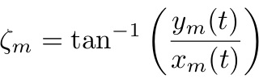
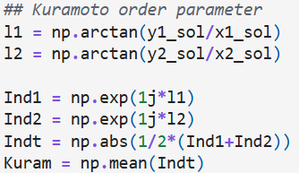
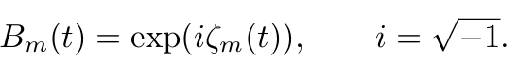
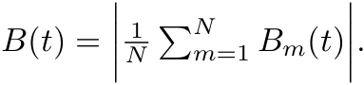
Kuramoto’ order parameter (Kuramoto and Battogtokh, 2002)
Phase of a neuron ‘m’ is
The complex valued Kuramoto index B is then
The index at time ‘t’ is then
When B = 1, this means the nodes are all fully coherent and their phases are all locked. Any value B < 1 represents incoherence.

Slide 19
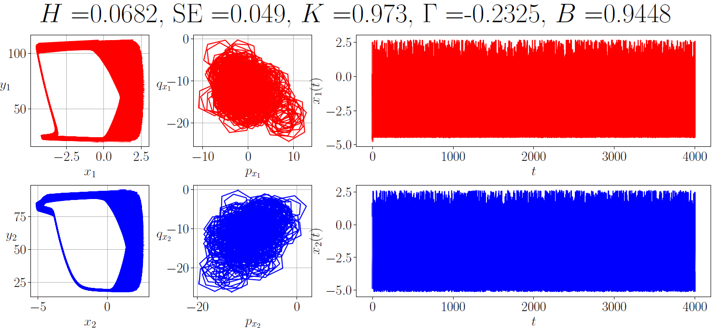
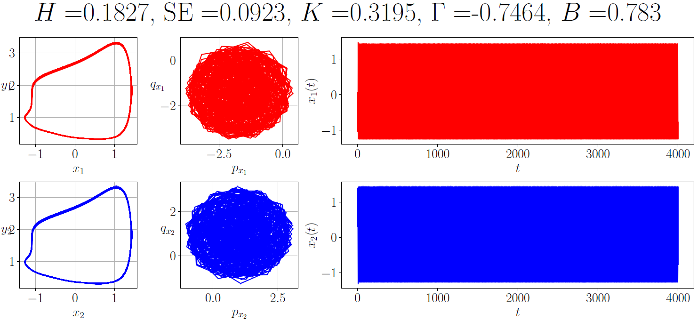
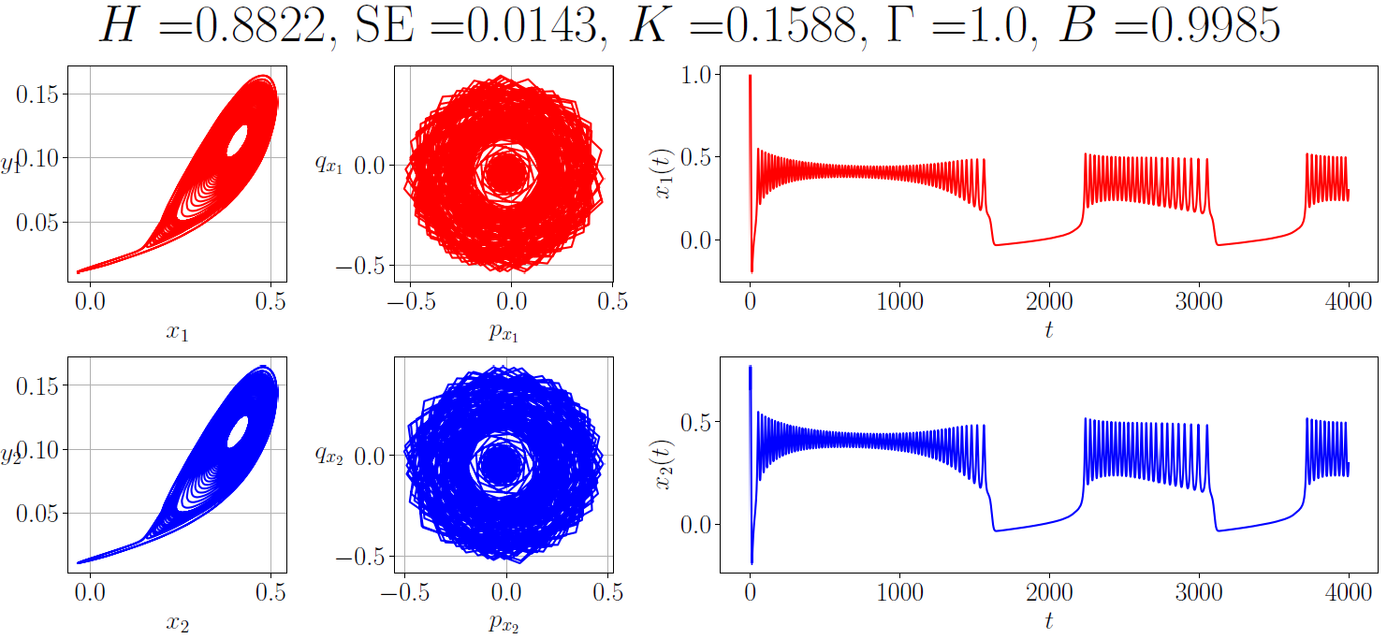
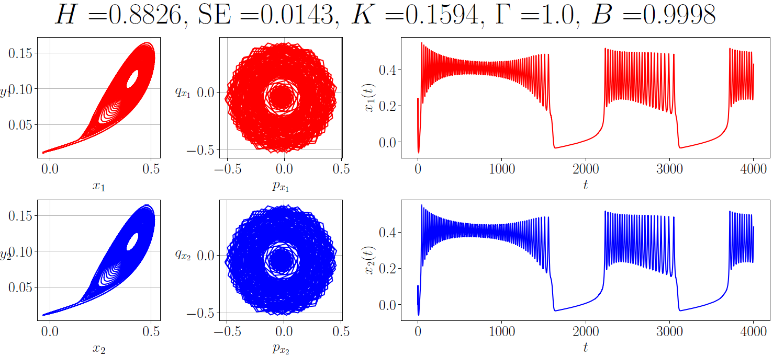
Results from gap-junction coupling

Slide 20
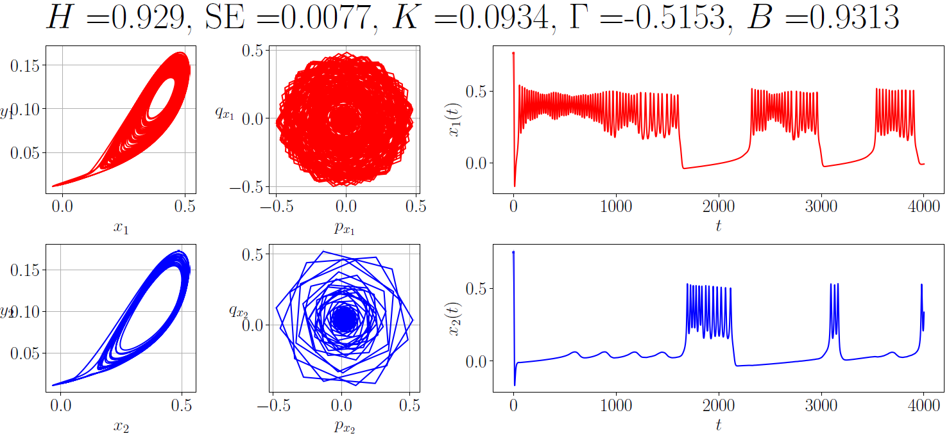
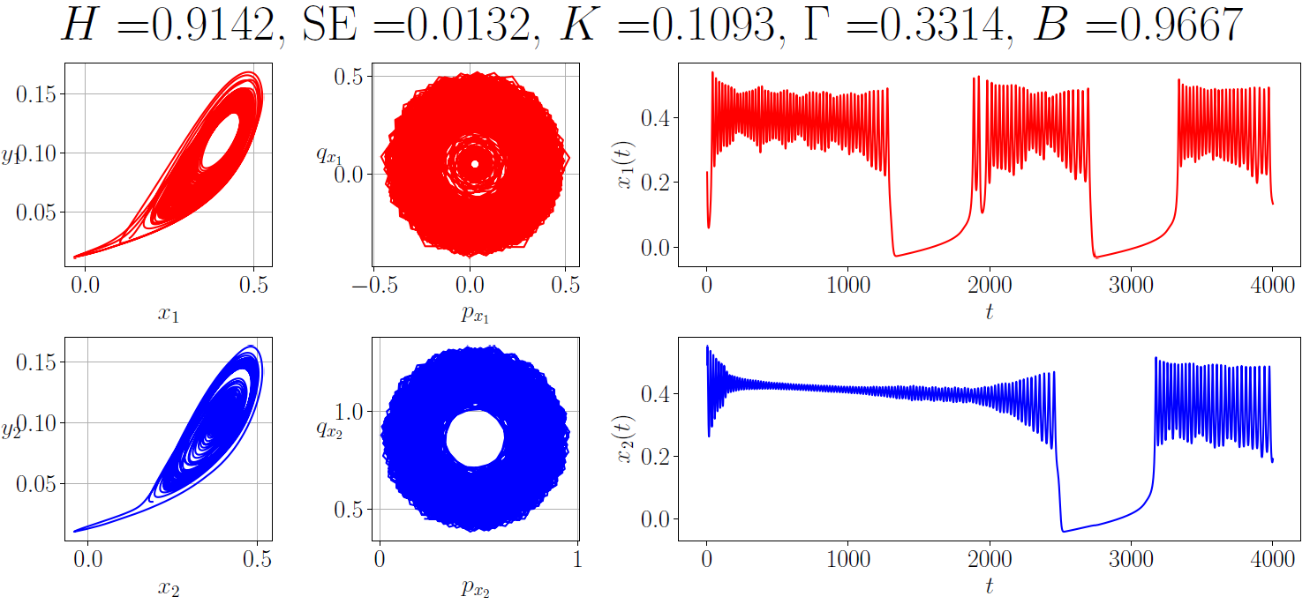
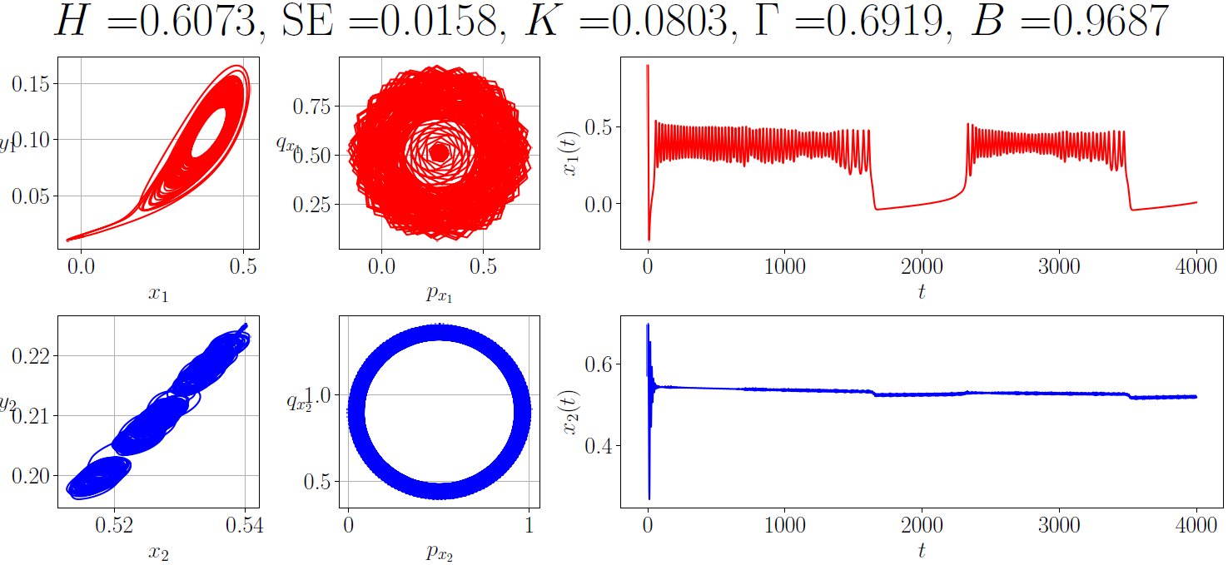
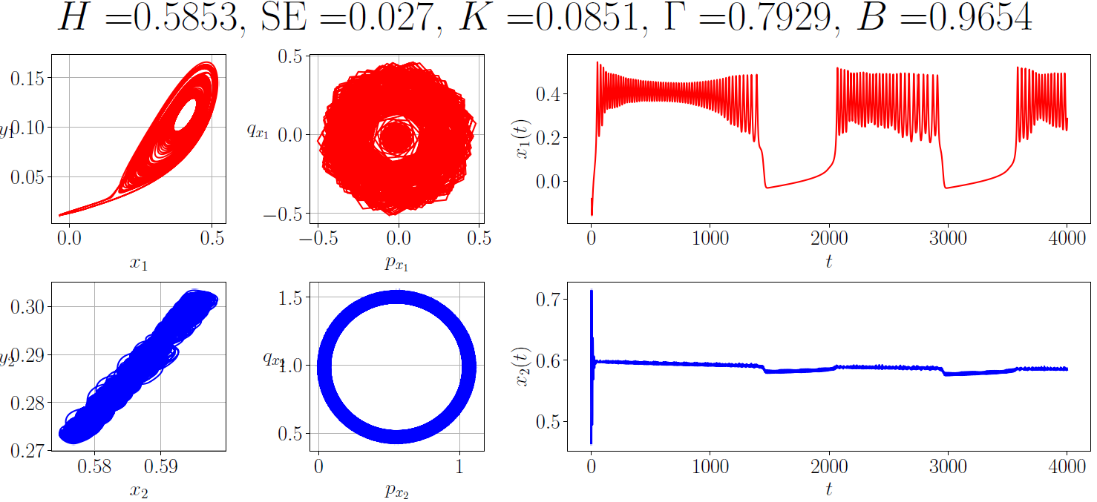
Results from chemical coupling

Slide 21
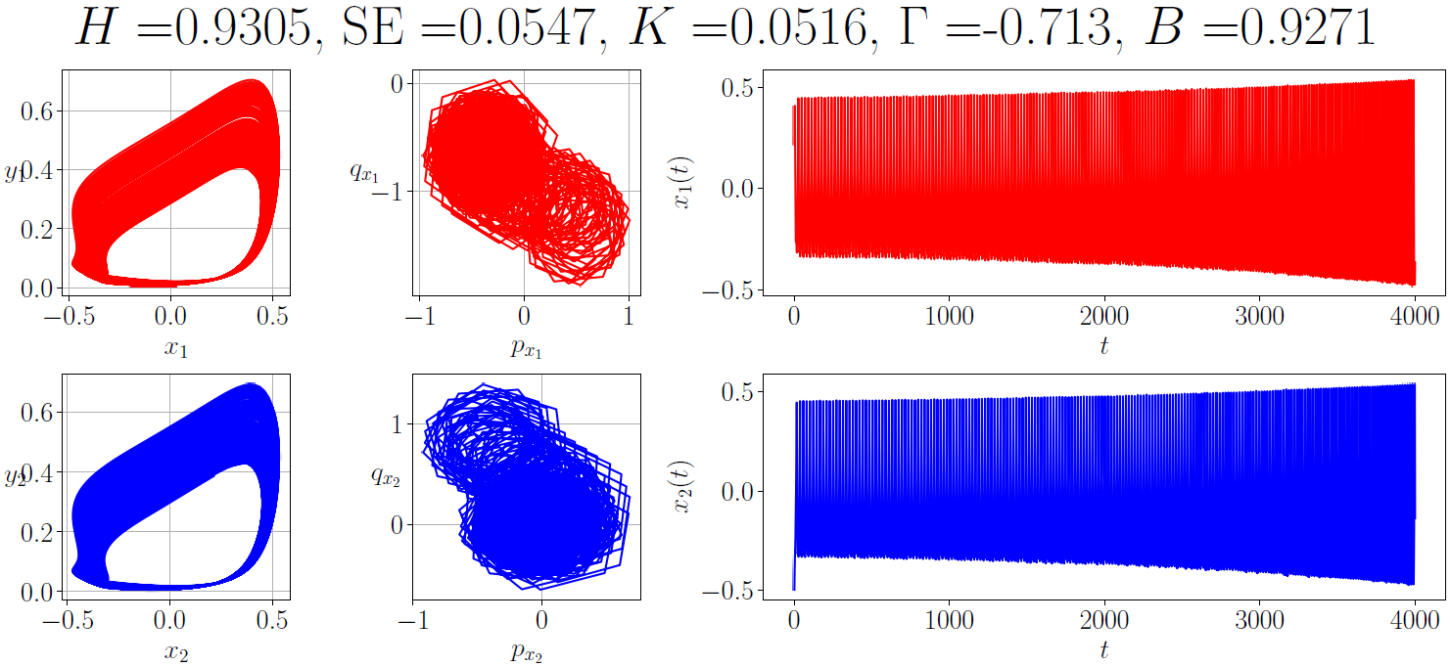
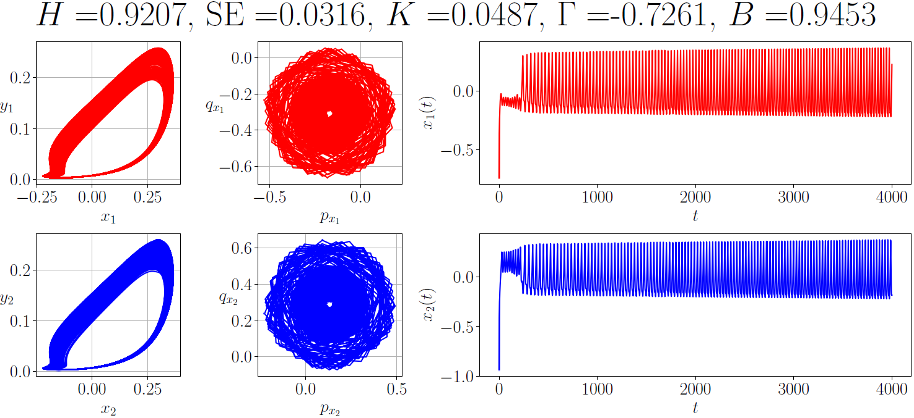
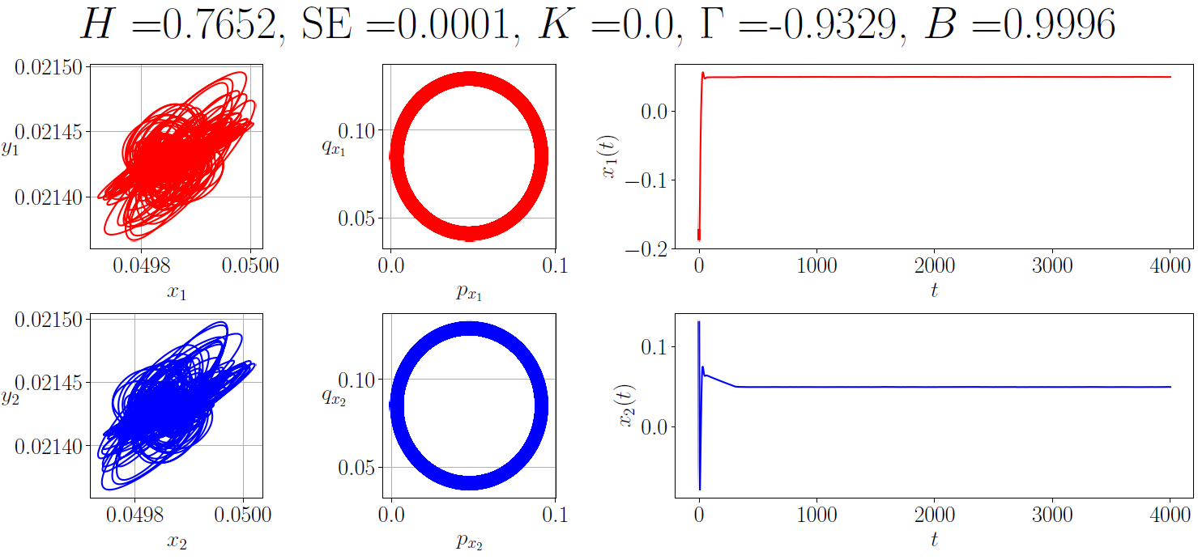
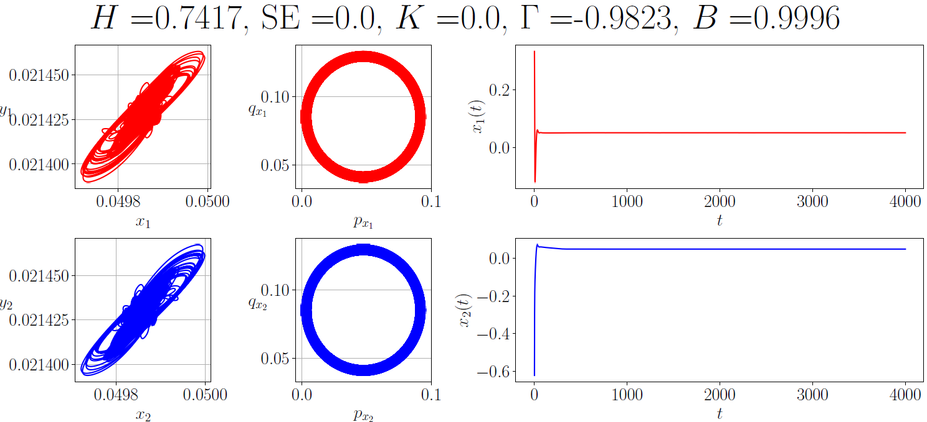
Results from electromagnetic coupling

Slide 22
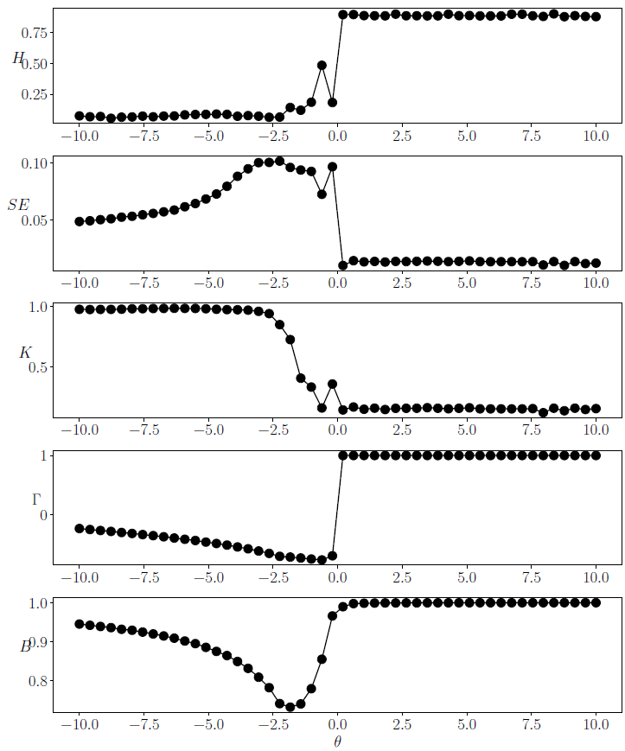
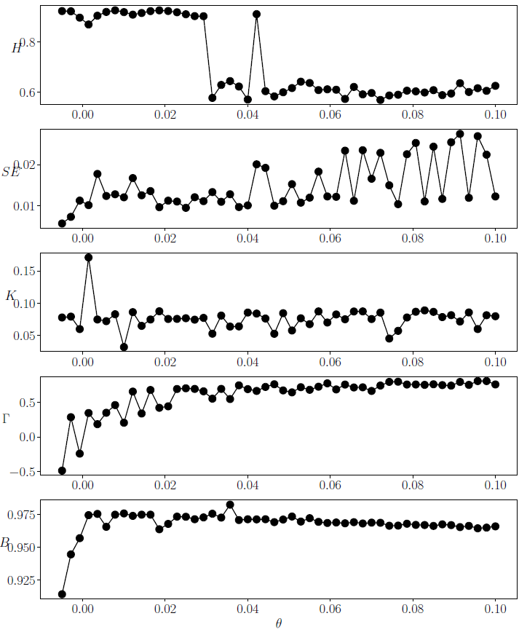
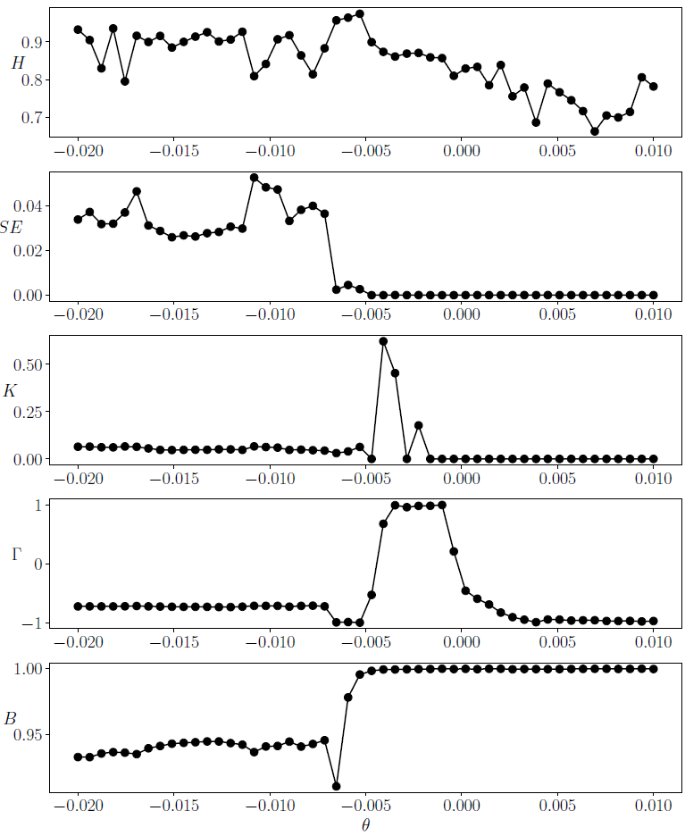
Plots with varying coupling strength

Slide 23


Summary
Coupling induces ‘chaos’ in the inhibitory regime.
Excitatory coupling and its more positive values drive the coupled system into exhibiting bursting. Also, both neurons synchronize.
In electromagnetic coupling, excitatory coupling drives the system to decay oscillation, falling into a symmetric equilibrium point.
Future work: move to GPU accelerated framework using `CuPy`:
Future work: use a complex network of neuron and integrate `NetworkX`:

Slide 24






Acknowledgements
Reference: Indranil Ghosh, Hammed Olawale Fatoyinbo, and Sishu Shankar Muni, “Time series analysis of coupled slow-fast neuron models: From Hurst exponent to Granger causality’’ (2025), arxiv.org/abs/2507.13570.
repository: github.com/indrag49/TS-SlowFast-dML

